Slide 1
June 2013 – May 2014

Slide 2
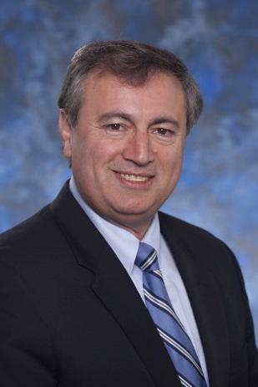
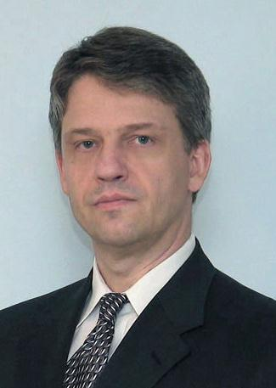
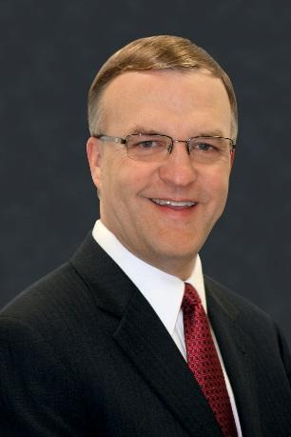
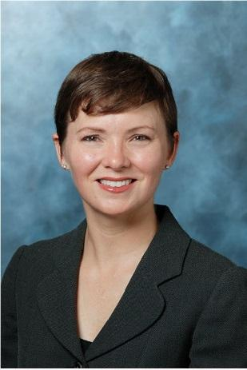
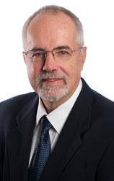
June 2013
AAMI 2013 – Long Beach
ACCE Clinical Engineering Symposium
Innovative and Disruptive Technologies
Speakers: James Welch, George Panagiotopoulos,
Jim Keller, Axel Wirth & Jennifer Jackson

Slide 3
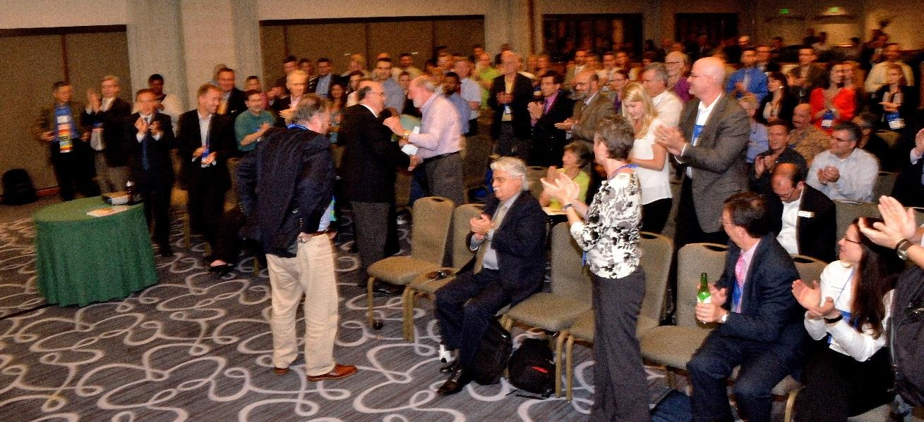
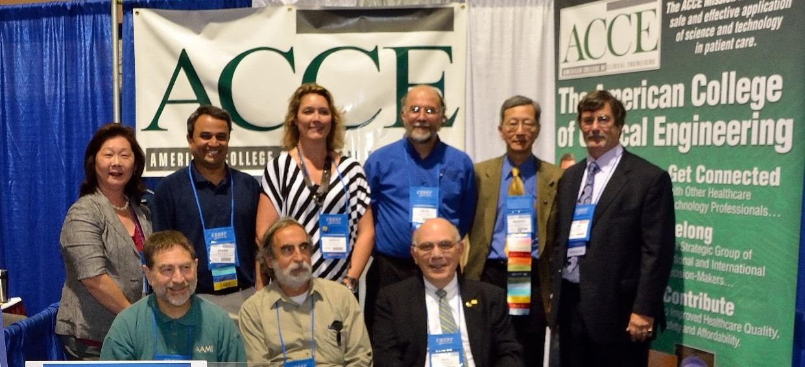
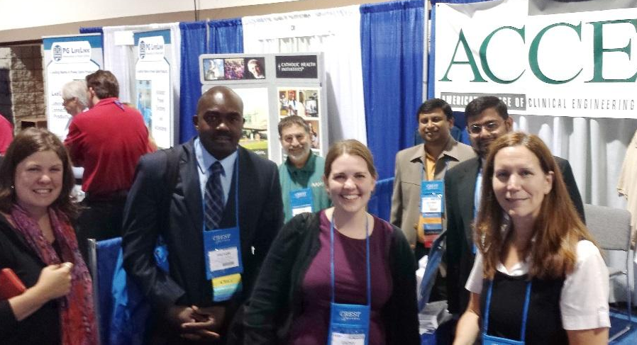
June 2013
ACCE at AAMI 2013 – Long Beach

Slide 4
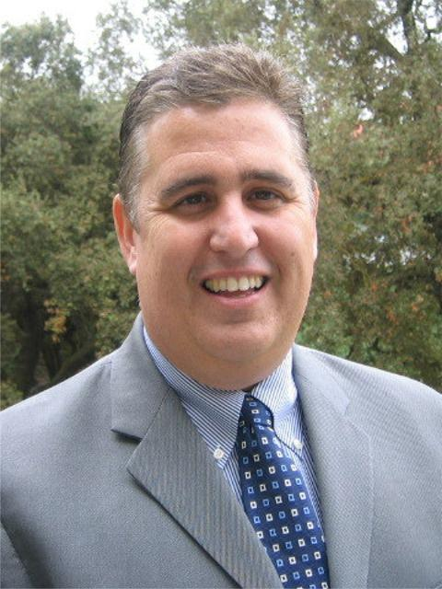
June 2013
Educational Webinar session# 10
Technology affecting Clinical Outcomes, Nursing Informatics
Speaker: Mark Sugrue RN

Slide 5
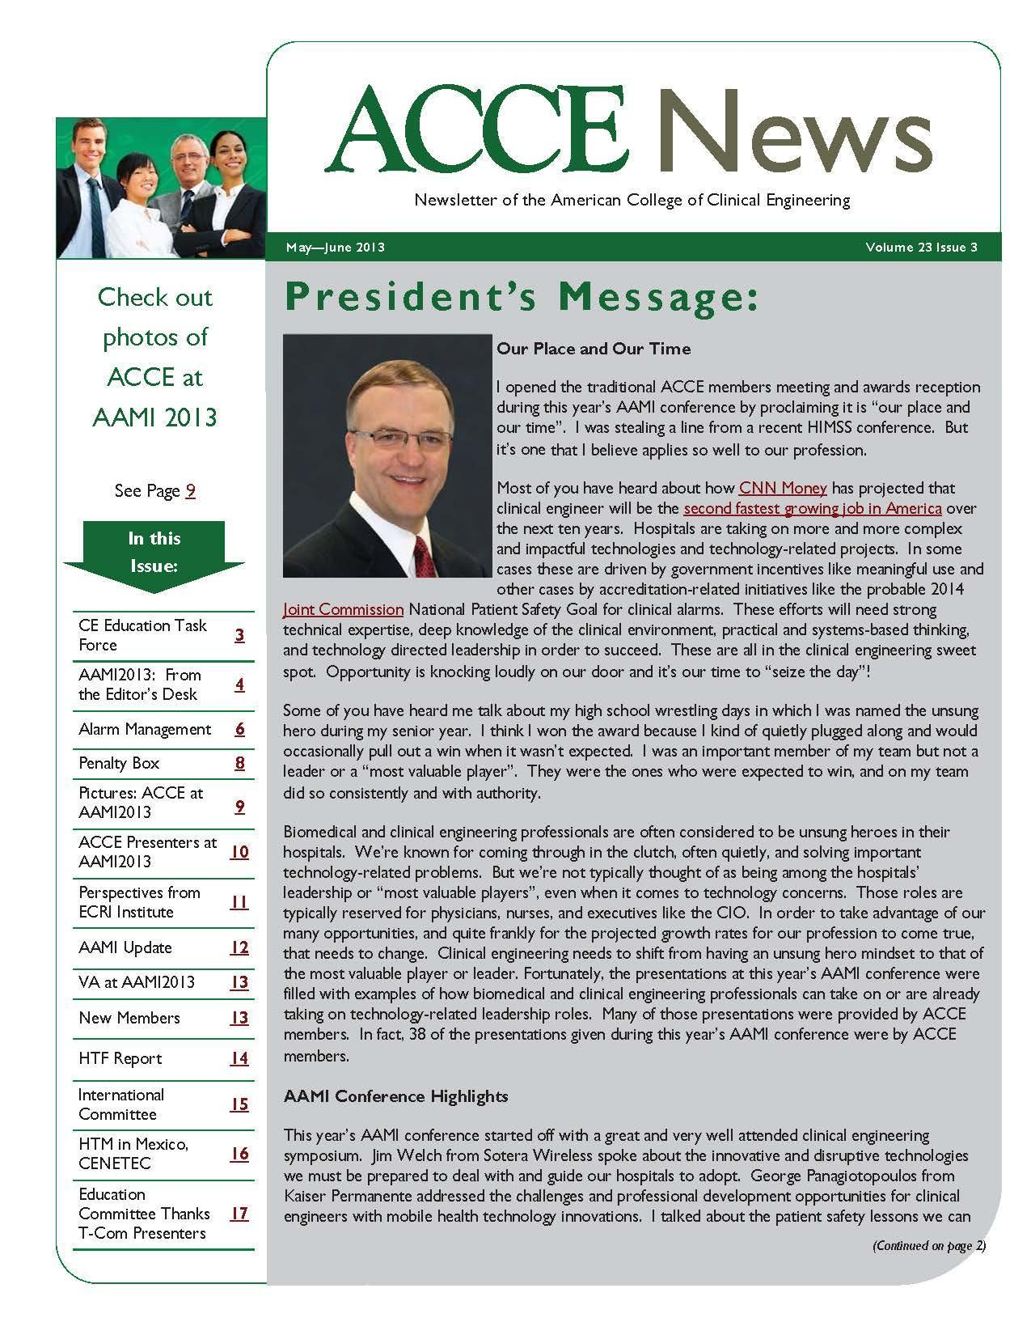
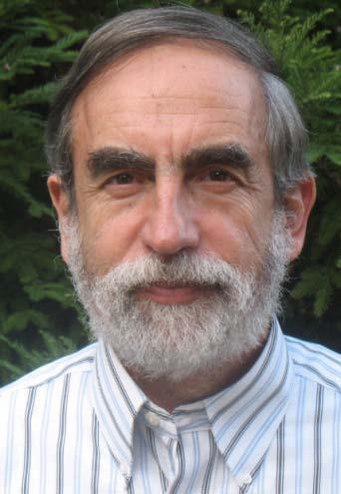
June 2013
ACCE Newsletter _Vol.23 Issue 3
Editor: Ted Cohen

Slide 6
JULY 2013 2013 ACCE BOARD ELECTION SLATE OF CANDIDATES
President
President-Elect
Vice President
Treasurer

Slide 7
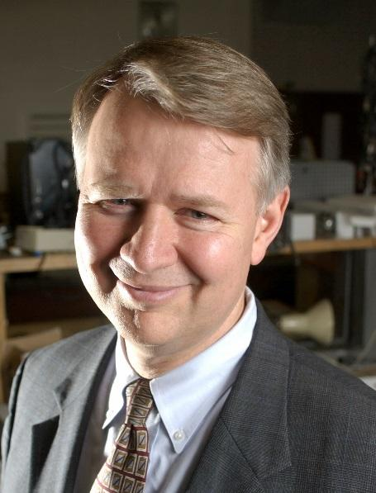
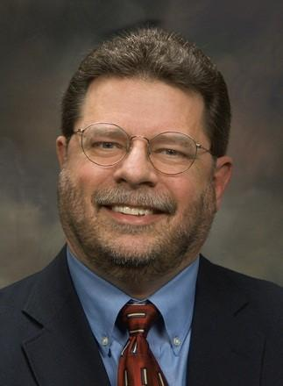
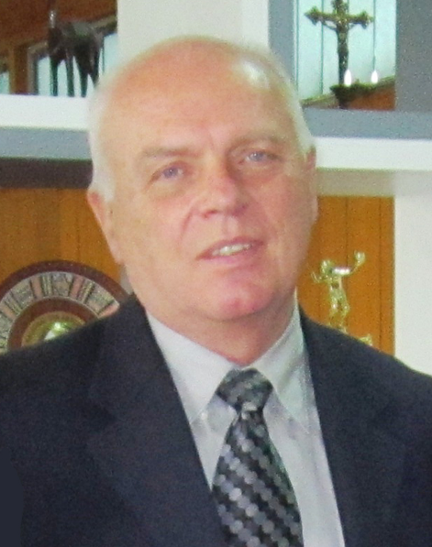
August - October 2013 2013 CCE Review Webinar FACULTY: Frank Painter, Matt Baretich, Tobey Clark, Ted Cohen

Slide 8
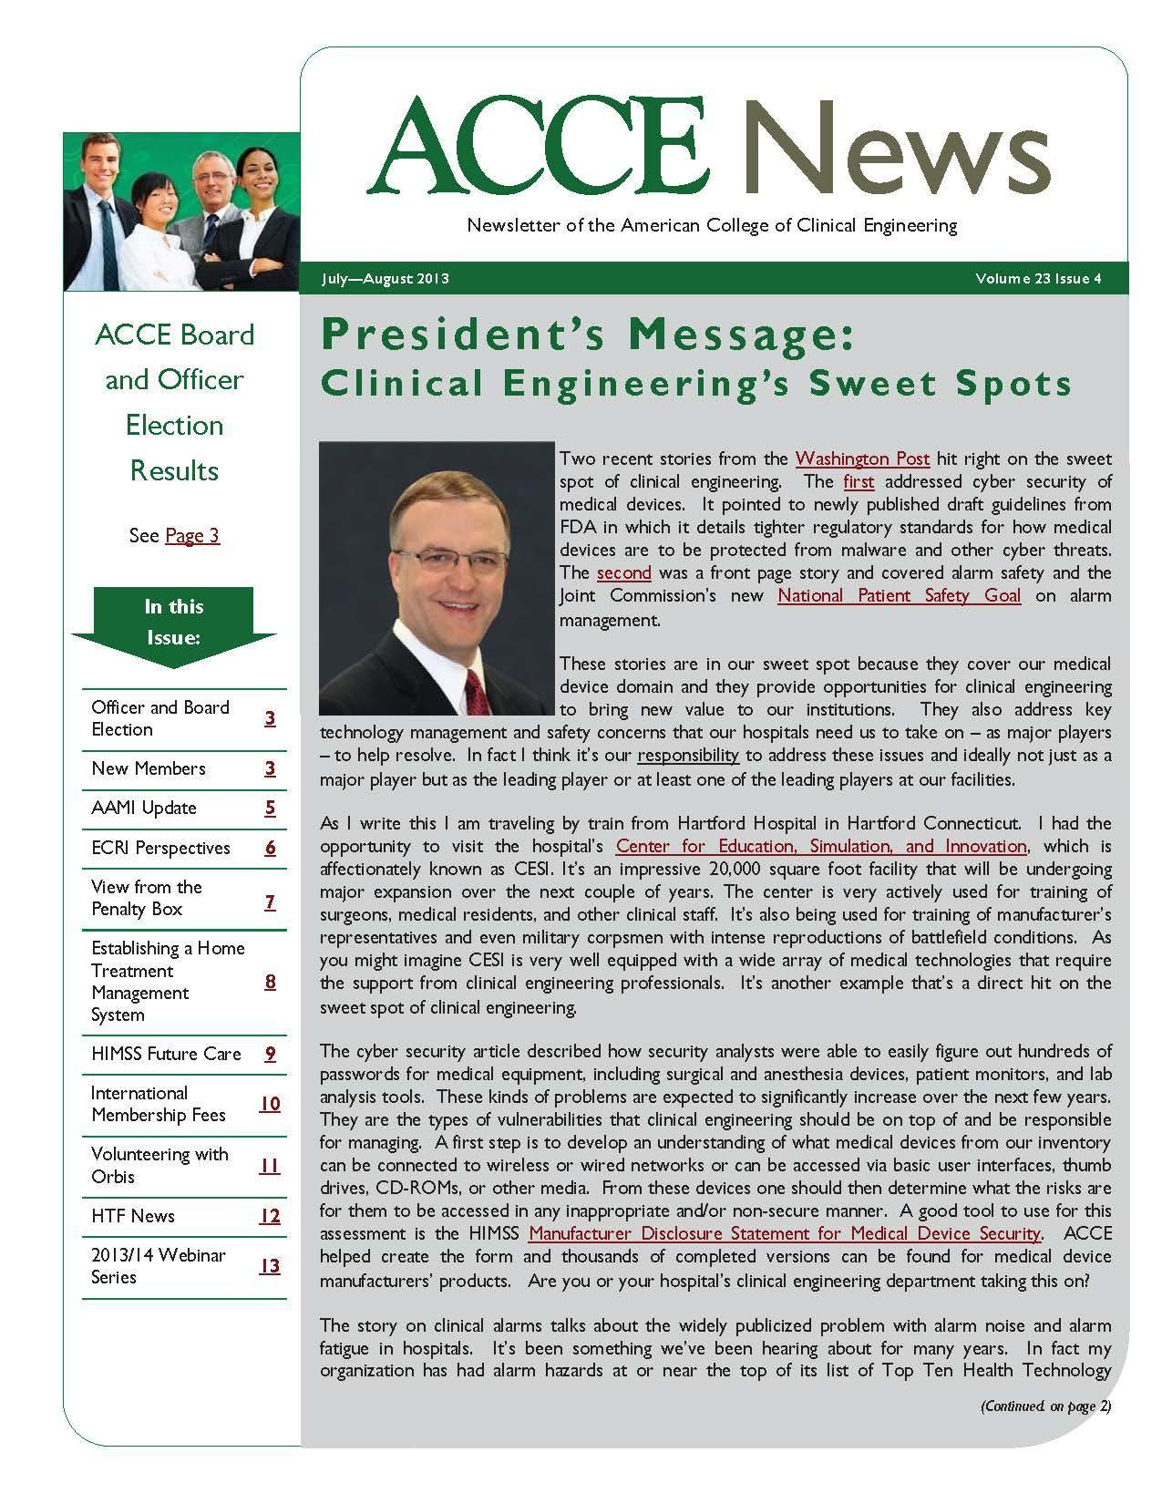
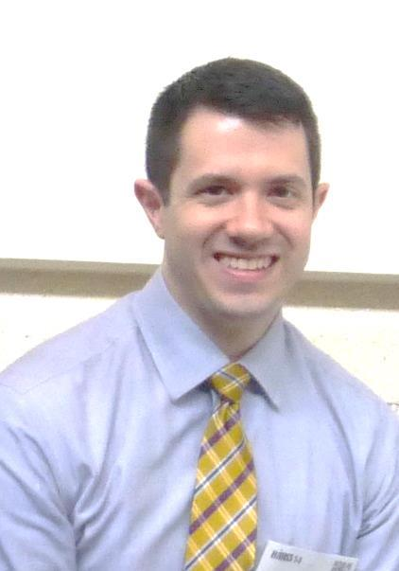
August 2013
ACCE Newsletter _Vol.23 Issue 4
Editor: Jared Ruckman

Slide 9
August 2013
ACEW Barranquilla – Colombia
Faculty: Mario Castañeda, Antonio Hernandez. Tobey Clark, Elliot Sloane

Slide 10
August 2013
ACEW Barranquilla - Colombia

Slide 11
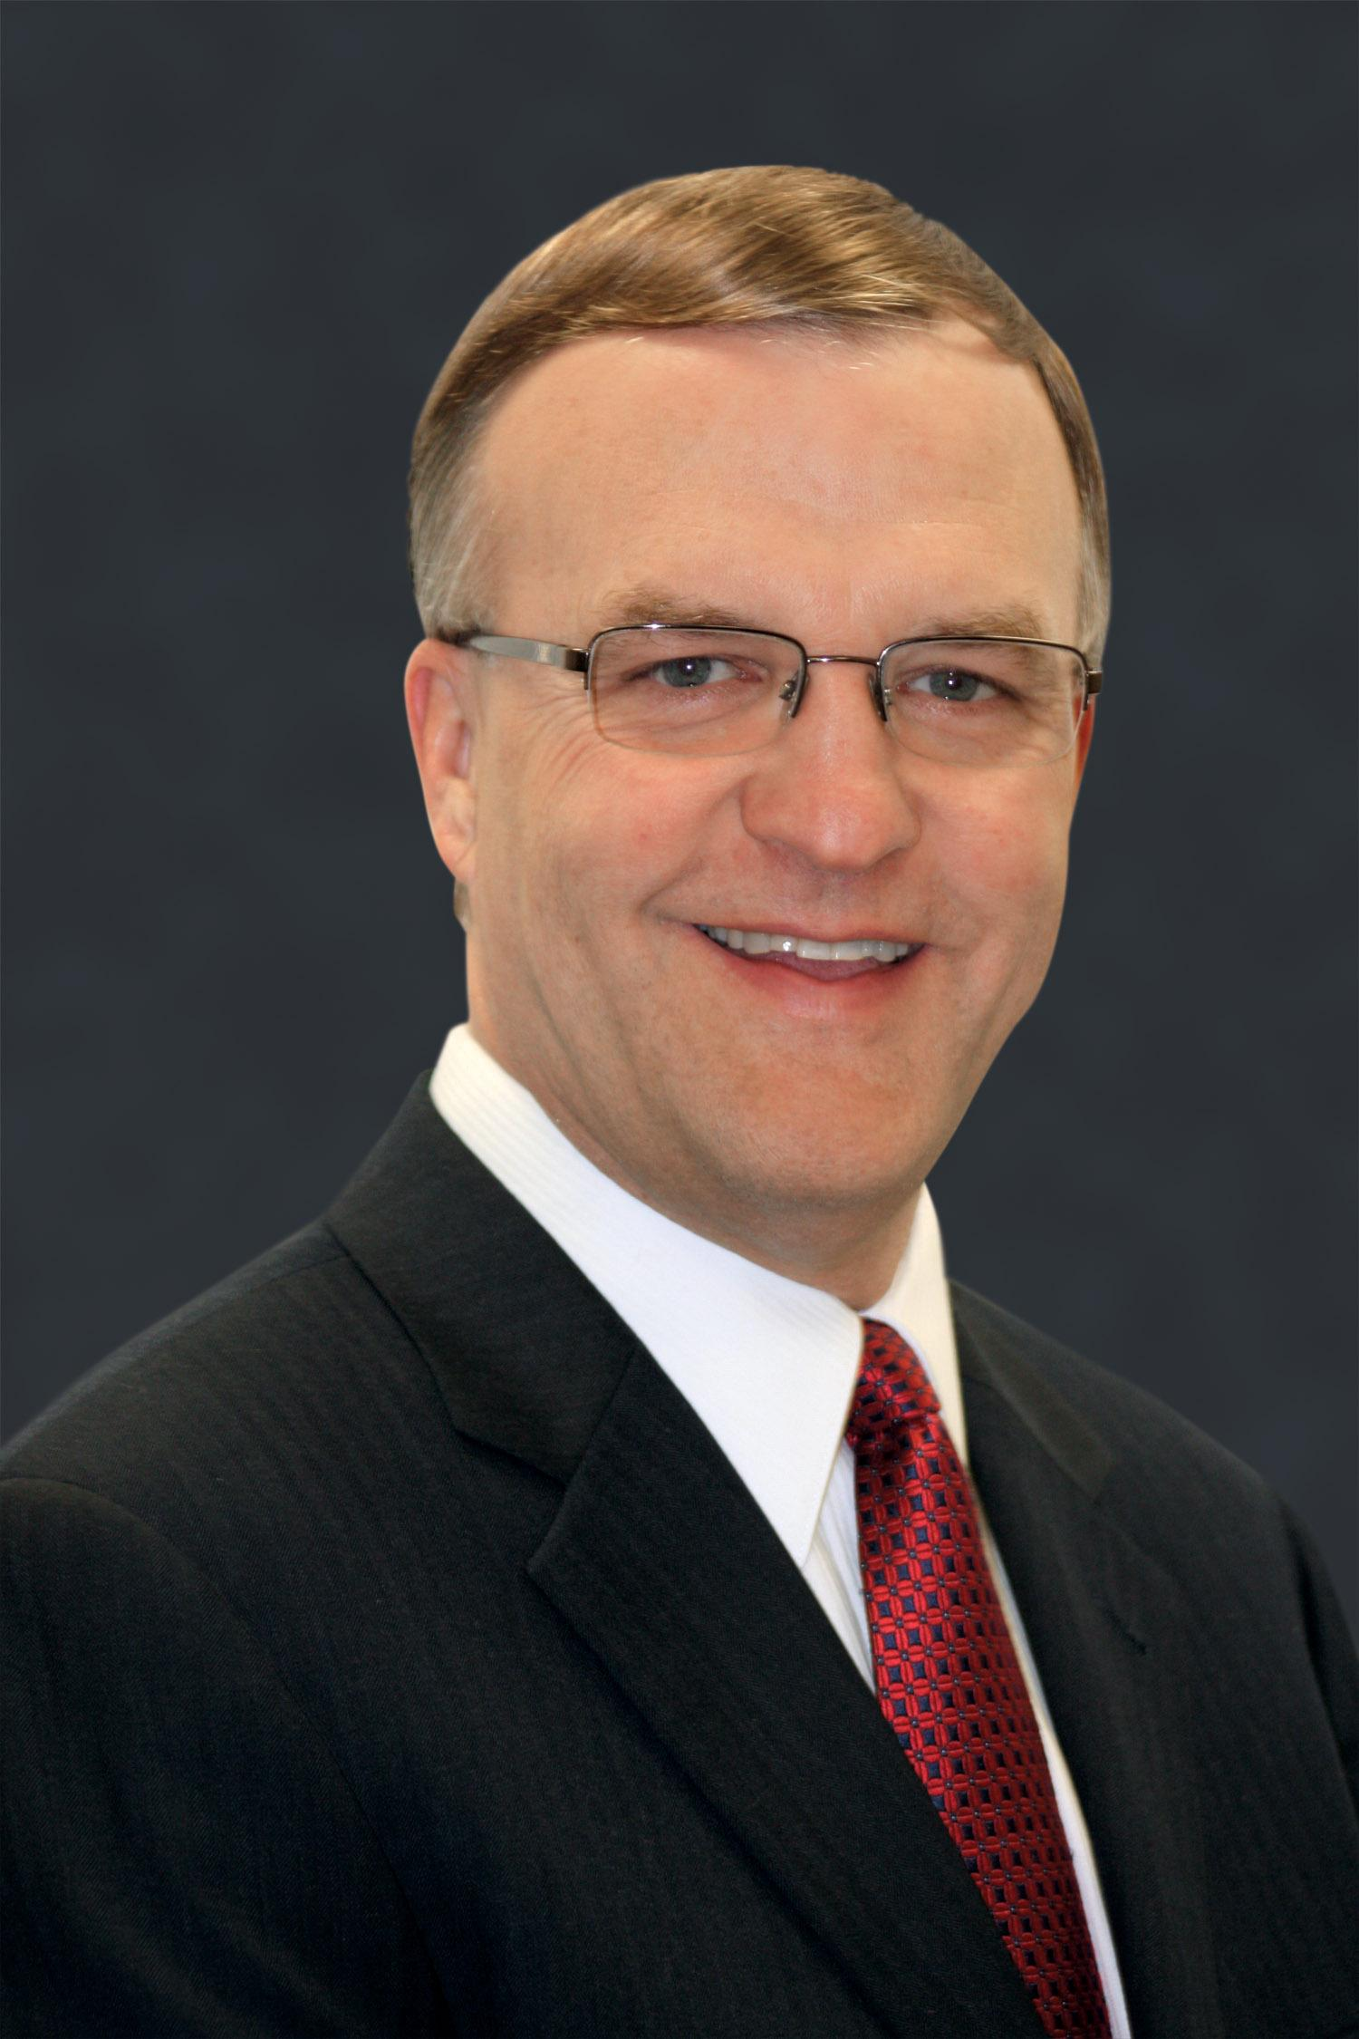
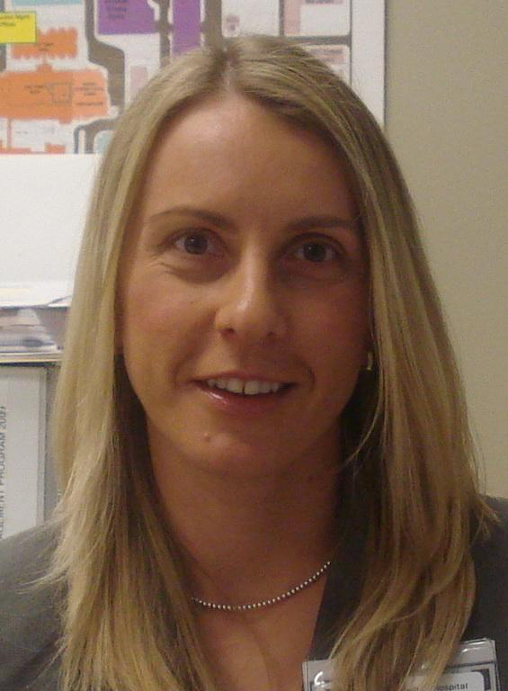
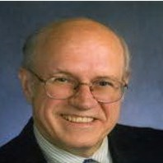
September 2013
Educational Webinar session # 1
Alarm Management Best Practices
Speakers: Jim Keller, Izabella Gieras & Thomas Bauld

Slide 12
October 2013
Virtual Members Meeting

Slide 13
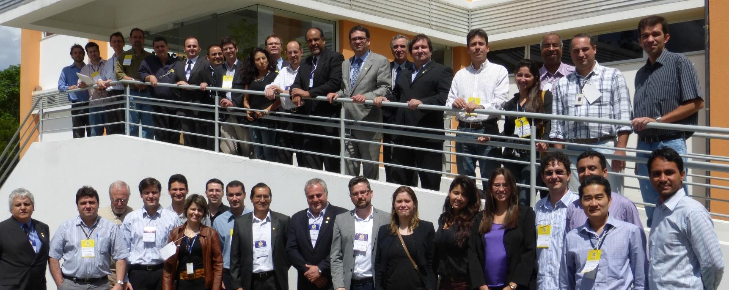
October 2013
ACEW Florianopolis - Brazil

Slide 14
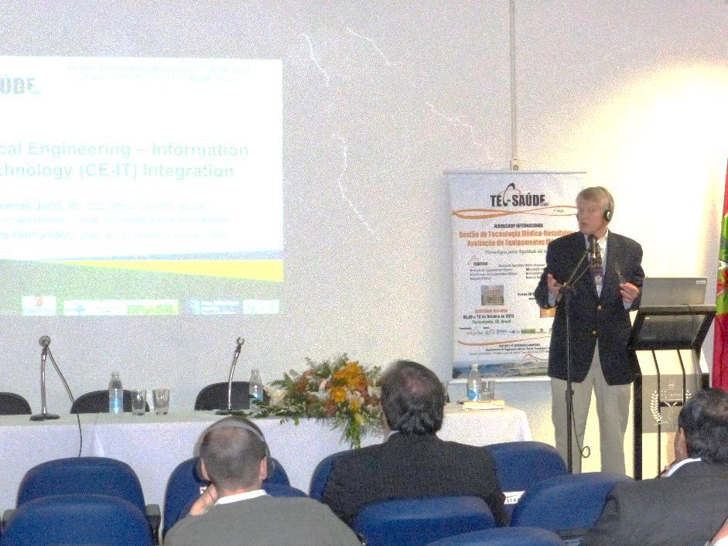
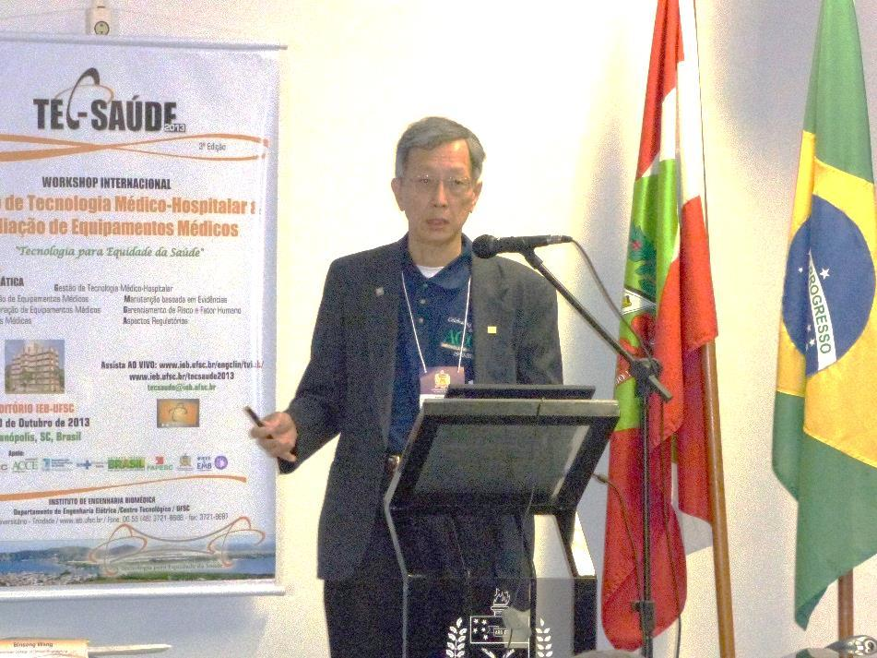
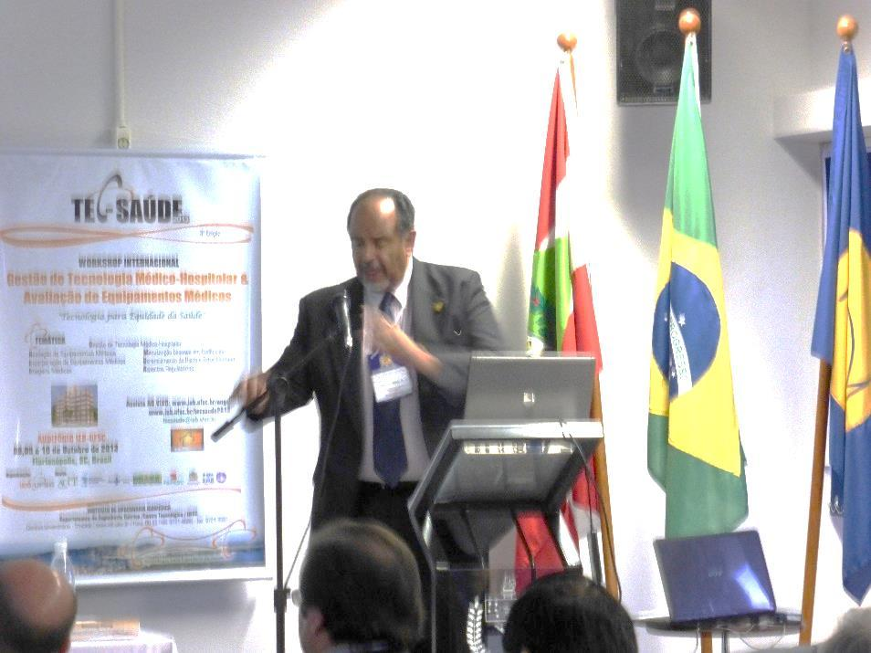
October 2013. ACEW Florianopolis – Brazil.
Faculty: Binseng Wang, Tom Judd, Antonio Hernandez, Ken Ross

Slide 15
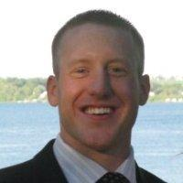
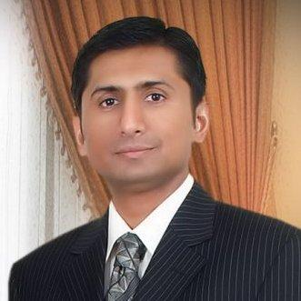
October 2013
Educational Webinar session # 2
Career Development and Succession Planning
Speakers: Chris Gutmann, Syed Samiullah & Jennifer Cavin

Slide 16
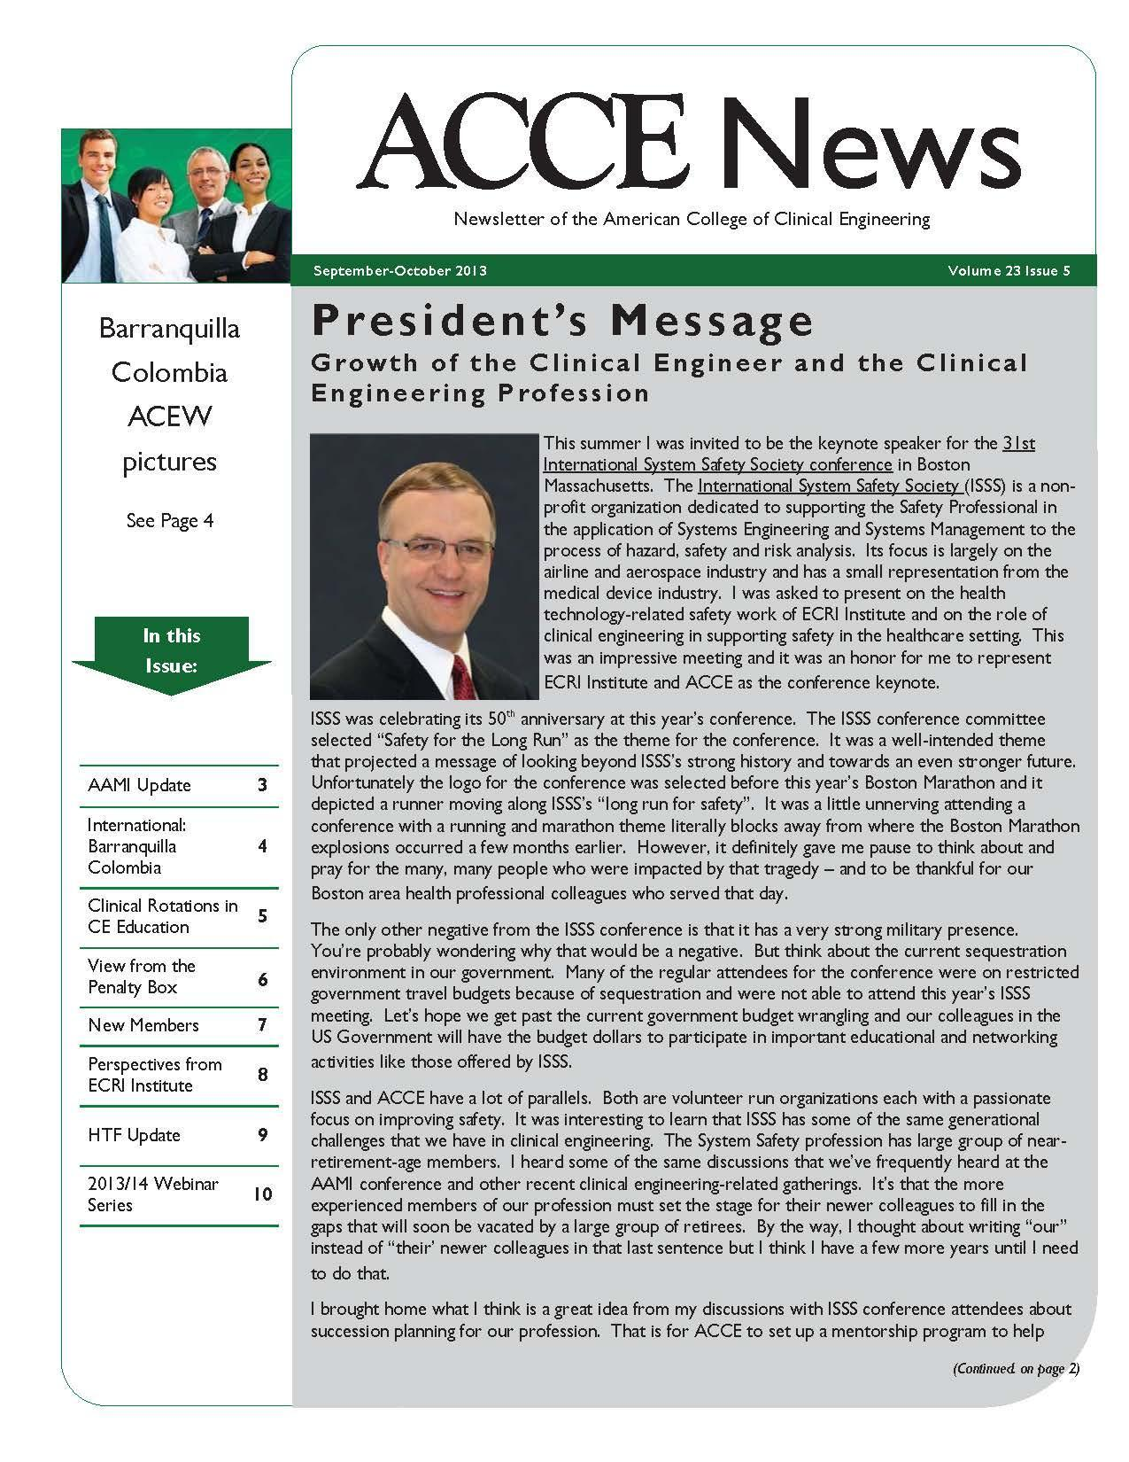
October 2013
ACCE Newsletter _Vol.23 Issue 5
Editor: Ted Cohen

Slide 17
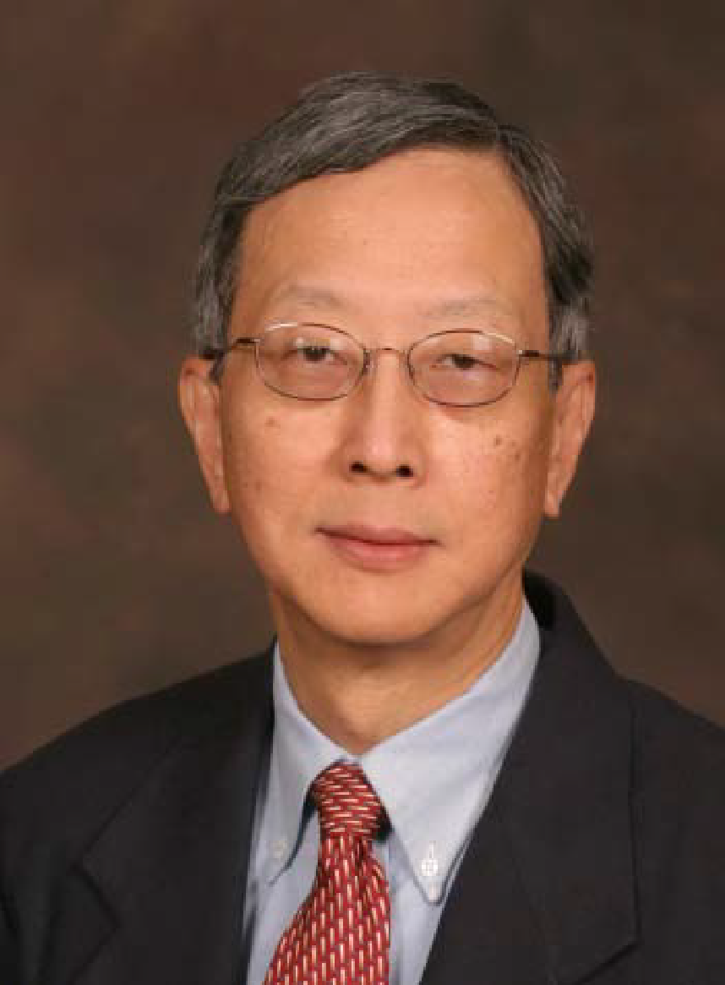
November 2013
Educational Webinar session # 3
Clinical Engineering Productivity Benchmarking
Speaker: Binseng Wang

Slide 18
November 2013 2nd WHO Global Forum - GENEVA

Slide 19
November 2013 2nd WHO Global Forum - GENEVA
Mario Castañeda presenting for Antonio Hernandez: Single Use Devices
Tom Judd at Ismael Cordero Poster

Slide 20
November 2013 2nd WHO Global Forum - GENEVA
Tobey Clark, ACCE ACEW presenter
Adriana Velazquez, CCE WHO Global HTM Leader

Slide 21
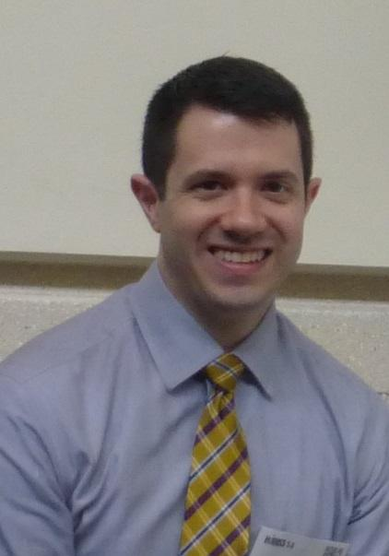
December 2013
ACCE Newsletter _Vol.23 Issue 6
Editor: Jared Ruckman

Slide 22
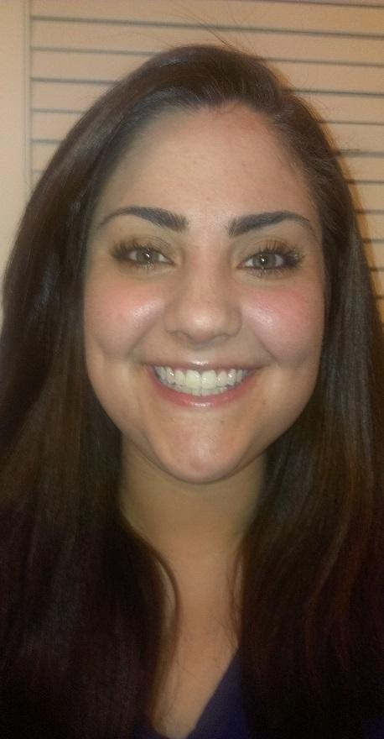
December 2013
Educational Webinar session # 4
Clinical Engineering Department Management
Speaker: Jennifer DeFrancesco

Slide 23
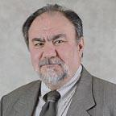
January 2014
Educational Webinar session # 5
RTLS 2.0
Speaker: Paul Frisch

Slide 24
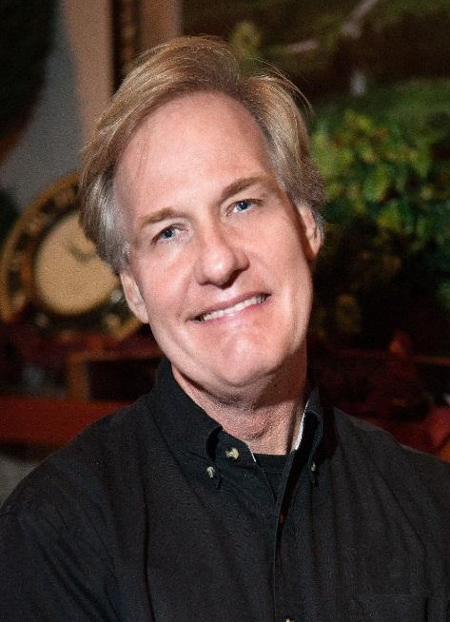
February 2014
Educational Webinar session # 6
IHE/PCD: Advancing Products and Integrating Workflows
Speaker: Dan Pettus

Slide 25
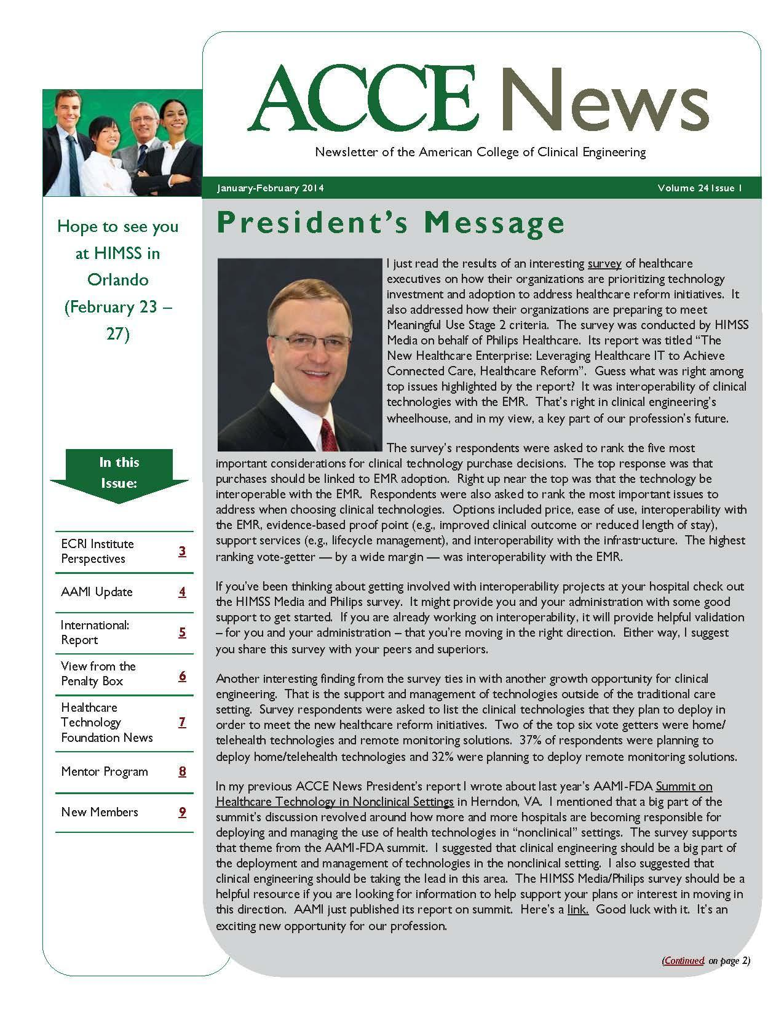
February 2014
ACCE Newsletter _Vol.24 Issue 1
Editor: Ted Cohen

Slide 26
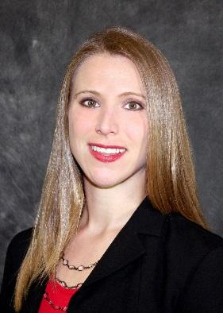
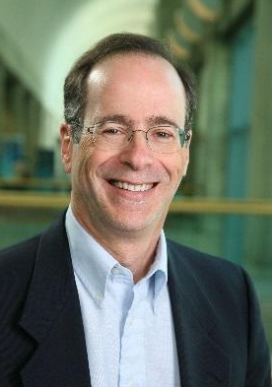
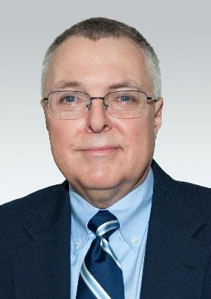
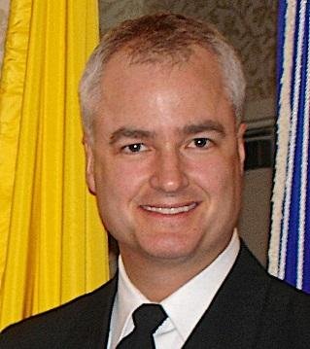
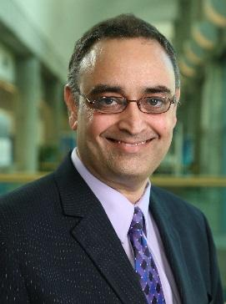
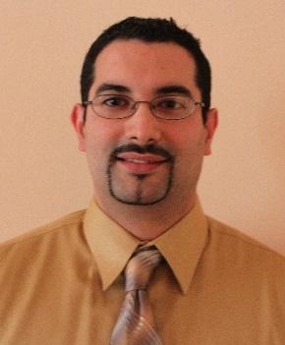
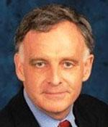
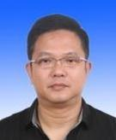
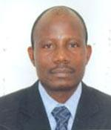
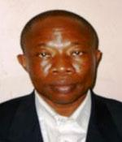
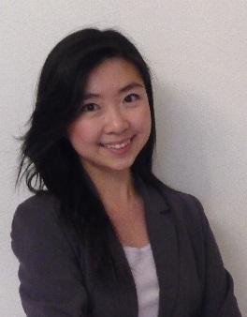
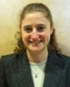
FEBRUARY 2014 2014 ADVOCACY AWARDS WINNERS ANNOUNCED

Slide 27
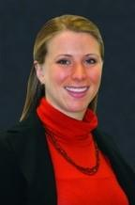
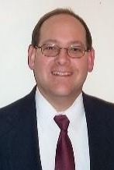
February 2014
HIMSS 2014 – Orlando
ACCE Educational Session
Are you covered? Practical Cybersecurity for Medical Devices
Speakers: Rick Hampton & Erin Sparnon

Slide 28
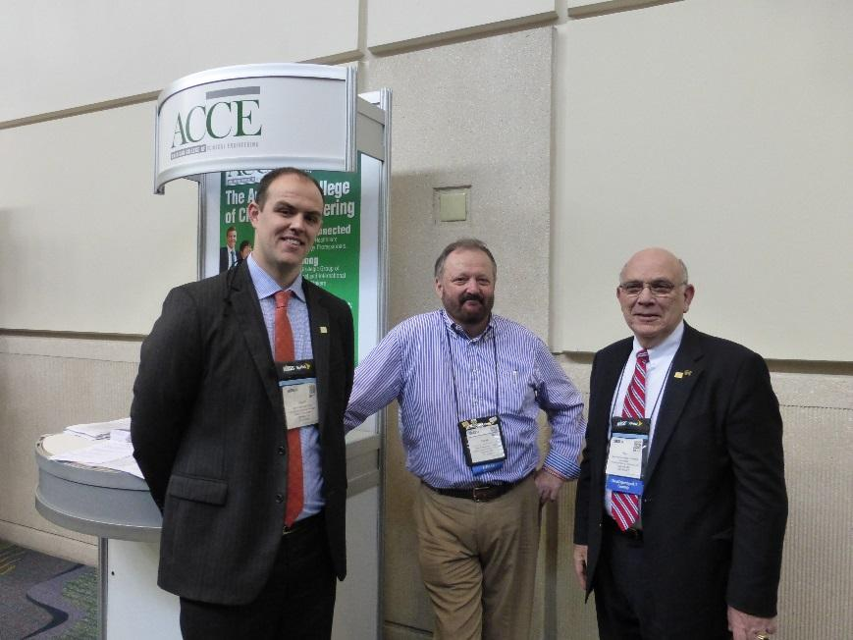
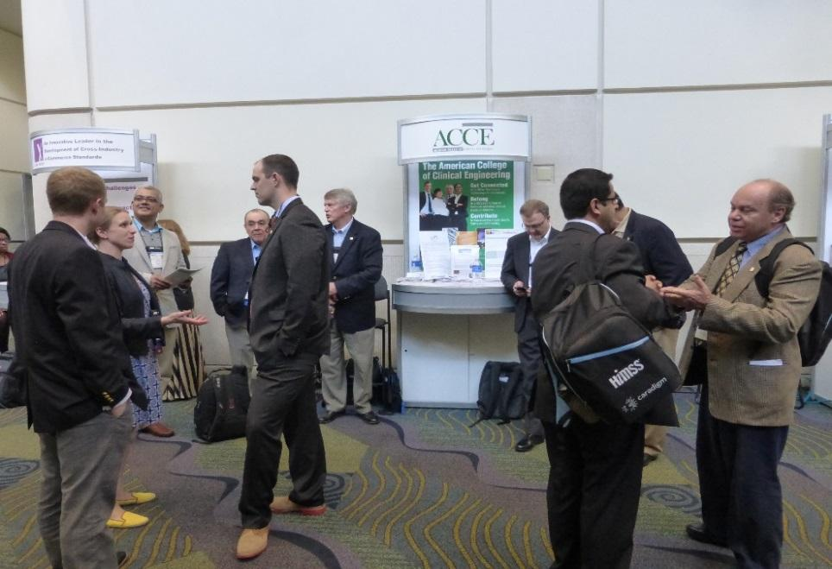
February 2014
HIMSS 2014 - Orlando

Slide 29
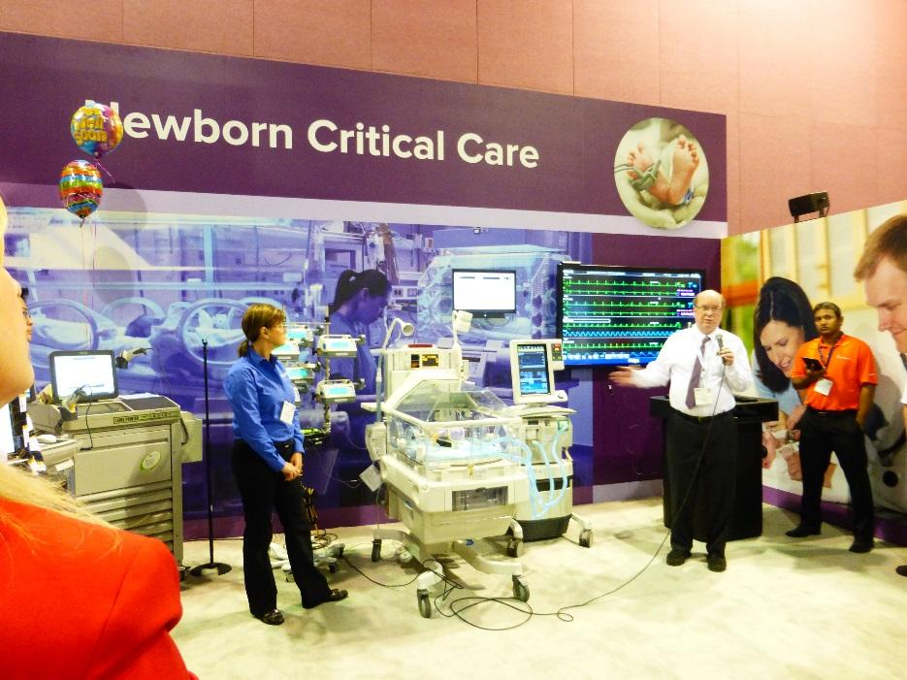
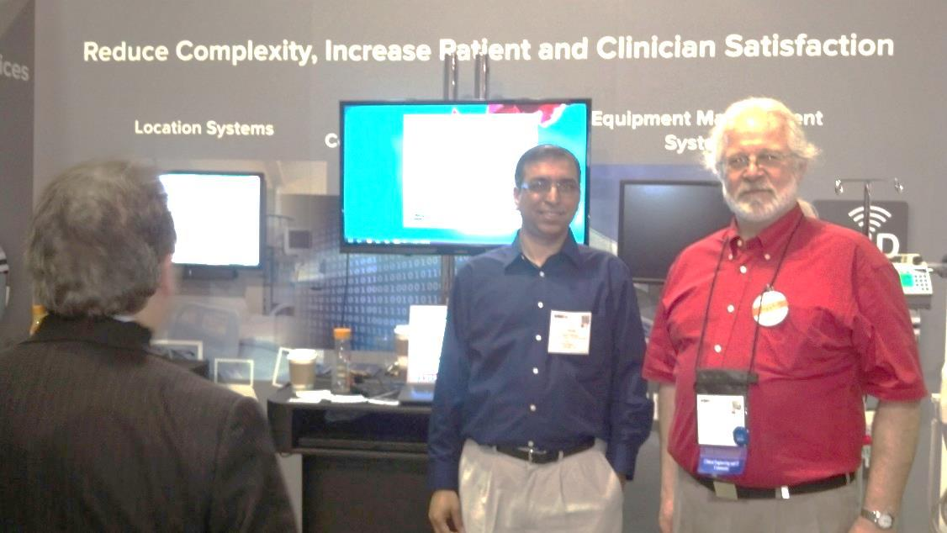
February 2014
HIMSS 2014 - Orlando

Slide 30
February 2014
HIMSS 2014 - Orlando

Slide 31
February 2014
HIMSS 2014 - Orlando

Slide 32
February 2014
HIMSS 2014 - Orlando

Slide 33
March 2014
Educational Webinar session # 7
CE/IT: Wireless Security
Speakers: Steve Grimes, Erin Sparnon

Slide 34
March 2014
25th Anniversary Logo Design Contest

Slide 35
April 2014
ACCE Newsletter _Vol.24 Issue 2
Editor: Jared Ruckman

Slide 36
April 2014
Educational Webinar session # 8
CE/IT: Change Management Best Practices
Speaker: Jacob Johnson

Slide 37
April 2014
3rd Virtual Membership Meeting

Slide 38
April 2014
Great appreciation to Past Board of Director: Jon Blasingame

Slide 39
April 2014
Great appreciation to Past Board of Director: Jon Blasingame

Slide 40
April 2014, Oakland, California
Great appreciation to Past Board of Director: Jon Blasingame

Slide 41
April 2014
Great appreciation to Past Board of Director: Jon Blasingame

Slide 42
May 2014
Educational Webinar session # 9
Continuous Care Model
Speaker: Kevin Phillips

Slide 44
June 2015
25th Anniversary celebration!

